Slide 1
Morphotectonic Parameter Assessment of a part of Ganga Basin using Geospatial Technology
Presented By:
Aditya Kale (224104005) Anmol Mohak (224357003)
Ankit Chandelia (224357002) Dipima Sarma (226157001)

Slide 2
CONTENTS
Introduction
Need of Study
Methodology
Data Collection
Parameters Calculation
Results and Conclusion
References

Slide 3
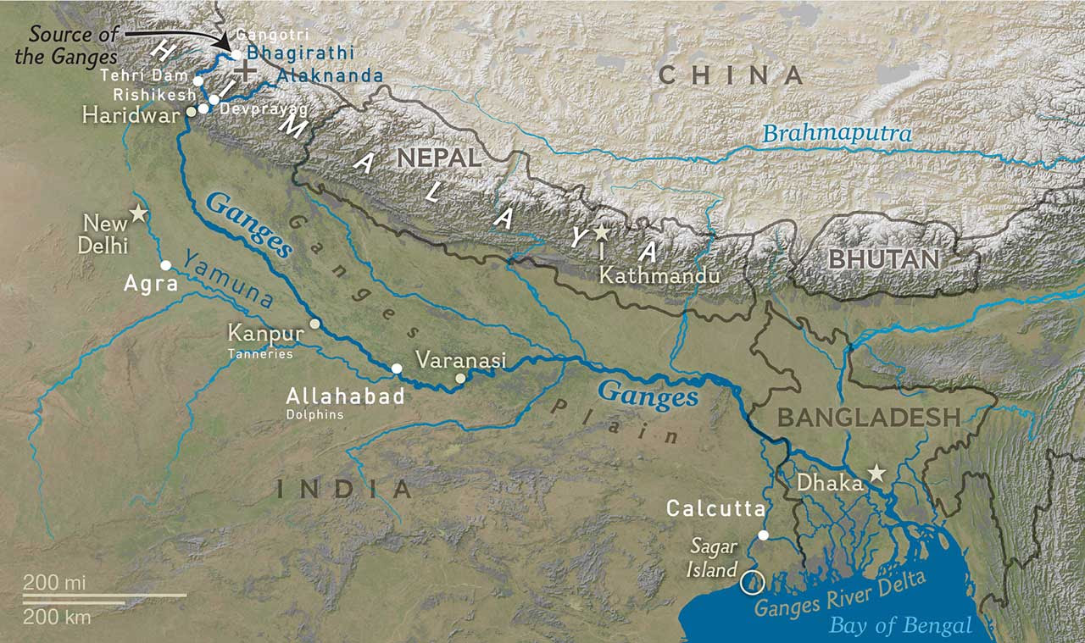
INTRODUCTION
Origin – Devprayag
Bhagirathi and Alakhnanda
Length – 2704 km
UP, Uttarakhand, MP, Chhattisgarh, Bihar, Jharkhand, Rajasthan, West Bengal, Haryana, Himachal Pradesh and Delhi
Seismic Zone V, IV & III
https://th.bing.com/th/id/OIP.D8rT1h9ZpV9D3zEPg6w06gHaEZ?w=316&h=187&c=7&r=0&o=5&pid=1.7

Slide 4
NEED OF STUDY
The morphometric parameters are significant in understanding the structural control of the basin by assessing its areal or relief characteristics (Thomas et al., 2010)
The information about tectonic history of an area can be retrieved by quantification of different morphotectonic indices, after obtaining the necessary information from topographic maps and satellite data (Keller, 1986)
Remote sensing plays a significant role in providing spatial information needed for computation of these indices
Dar et al. (2014) used morphometric and morphotectonic parameters to identify the tectono-geomorphic evolution of the Karewa basin of Kashmir valley, India, and observed the significant role of late Quaternary climate changes and tectonic upliftment in the valley landscape evolution
Anand et al., (2019) calculated geomorphic indices and morphometric parameters in a part of the Ganga basin to investigate neotectonics activities as they are the controlling factor in development of landforms in tectonically active terrains

Slide 5
METHODOLOGY
GIS ANALYSIS
Fill DEM
Flow direction
Flow accumulation
Flow length calculation
Stream network delineation
Selection of outlet point
Watershed delineation
Spatial extraction using watershed boundary
River centreline delineation
Floodplain demarcation
LITERATURE SURVEY
Research problem identification
Data selection
Morphometric Parameters selection
DATA DOWNLOAD AND PROCESSING
MSS data download, layer stacking and mosaicking
DEM data download and mosaicking
MORPHOTECTONIC ANALYSIS
Basin Elongation Ratio
Transverse Topographic Symmetry
Asymmetric Factor
Valley Floor Width to Valley Height Ratio
Mountain Front Sinuosity
Stream Length Gradient Index
INFERENCE ON INFLUENCE OF TECTONIC ACTIVITIES ON CHANNEL EVOLUTION OF GANGA RIVER

Slide 6
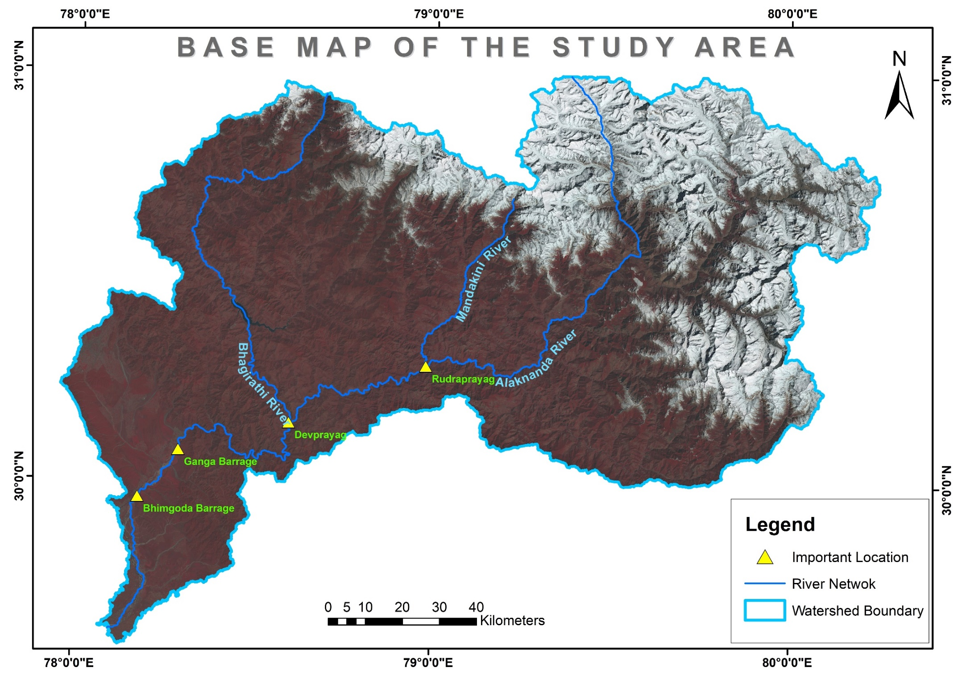
Study area:
Rudraprayag: Confluence of Mandakini and Alaknanda
Devprayag: Confluence of Bhagirathi and Alaknanda
Ganga Barrage:
Near Kanpur
Bhimgoda Barrage (Irrigation, HEP, Flood control) : Near Haridwar

Slide 7
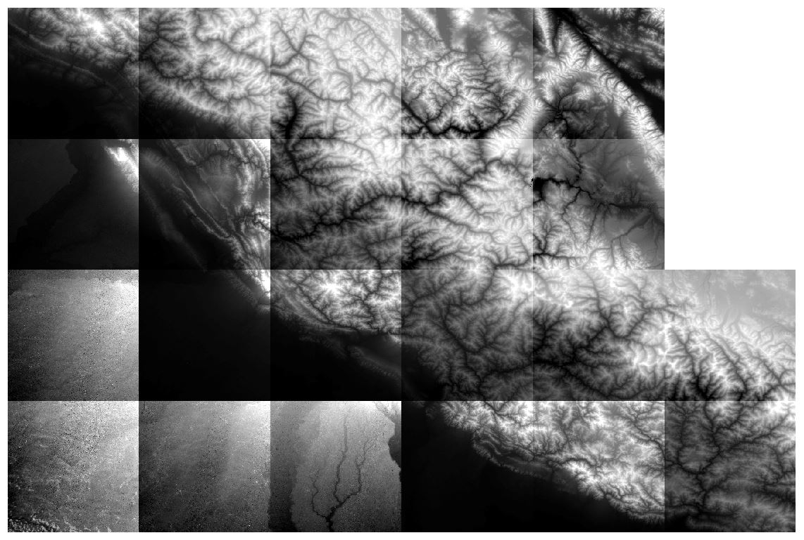
DATA COLLECTION
CartoDEM (Version 3) – 30m
Horizontal accuracy: 15m
Vertical accuracy: 8m
Extent:
29°23’22”N to 31°11’30”N
76°38’41”E to 80°19’18”E
22 tiles
29th April 2015

Slide 8
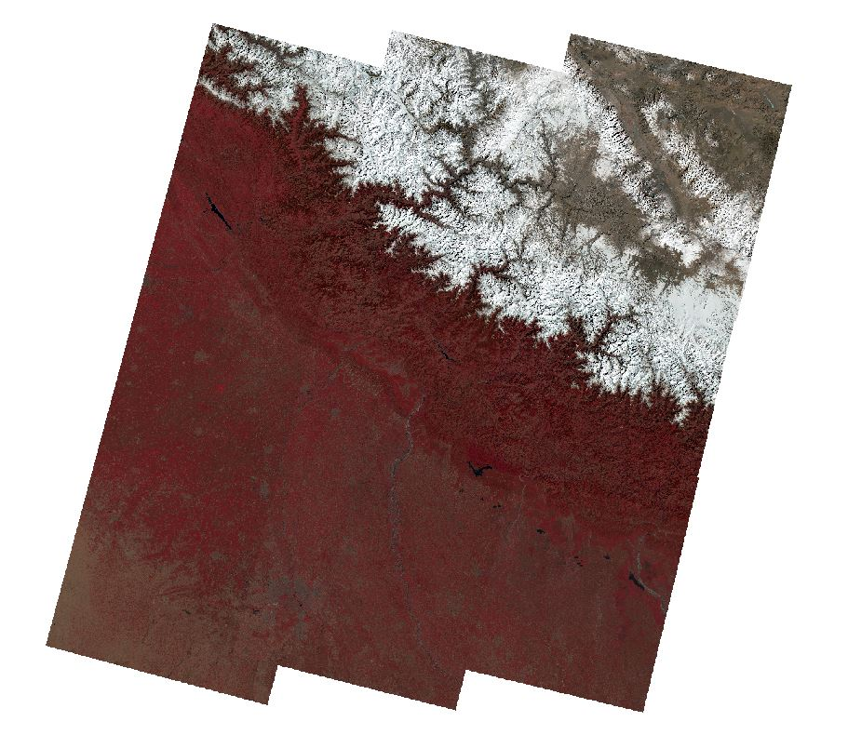
DATA COLLECTION
Landsat 8 data (Level 2)
30 meters
Co-ordinates:
29°23’22” to 31°11’30” North
76°38’41” to 80°19’18” East
9 tiles
8th Feb 2022 to 28th March 2022

Slide 9
DEM PROCESSING AND GIS ANALYSIS

Slide 10
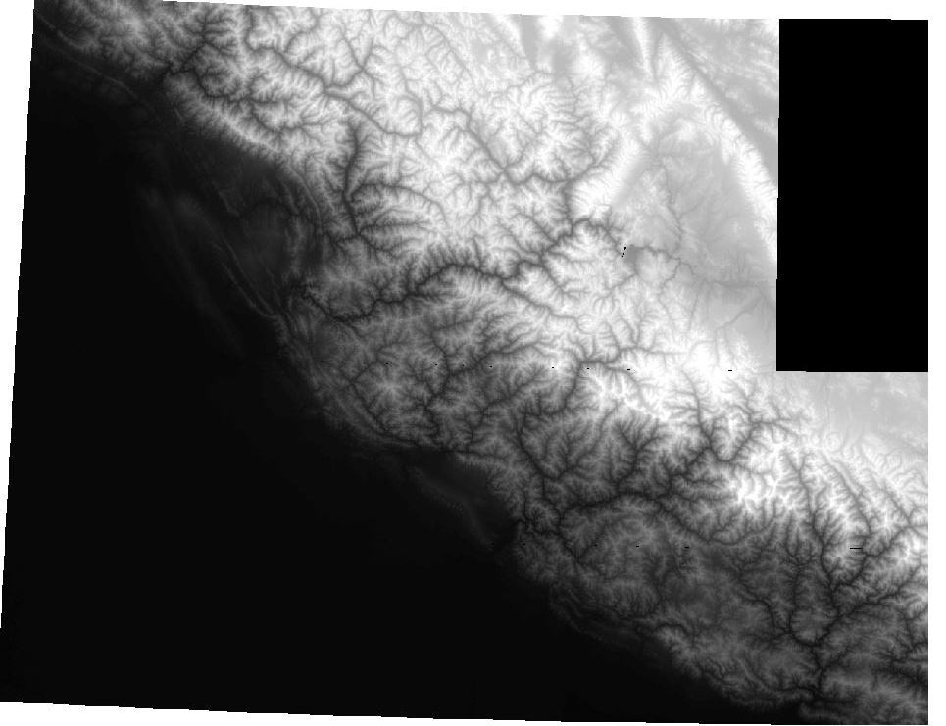
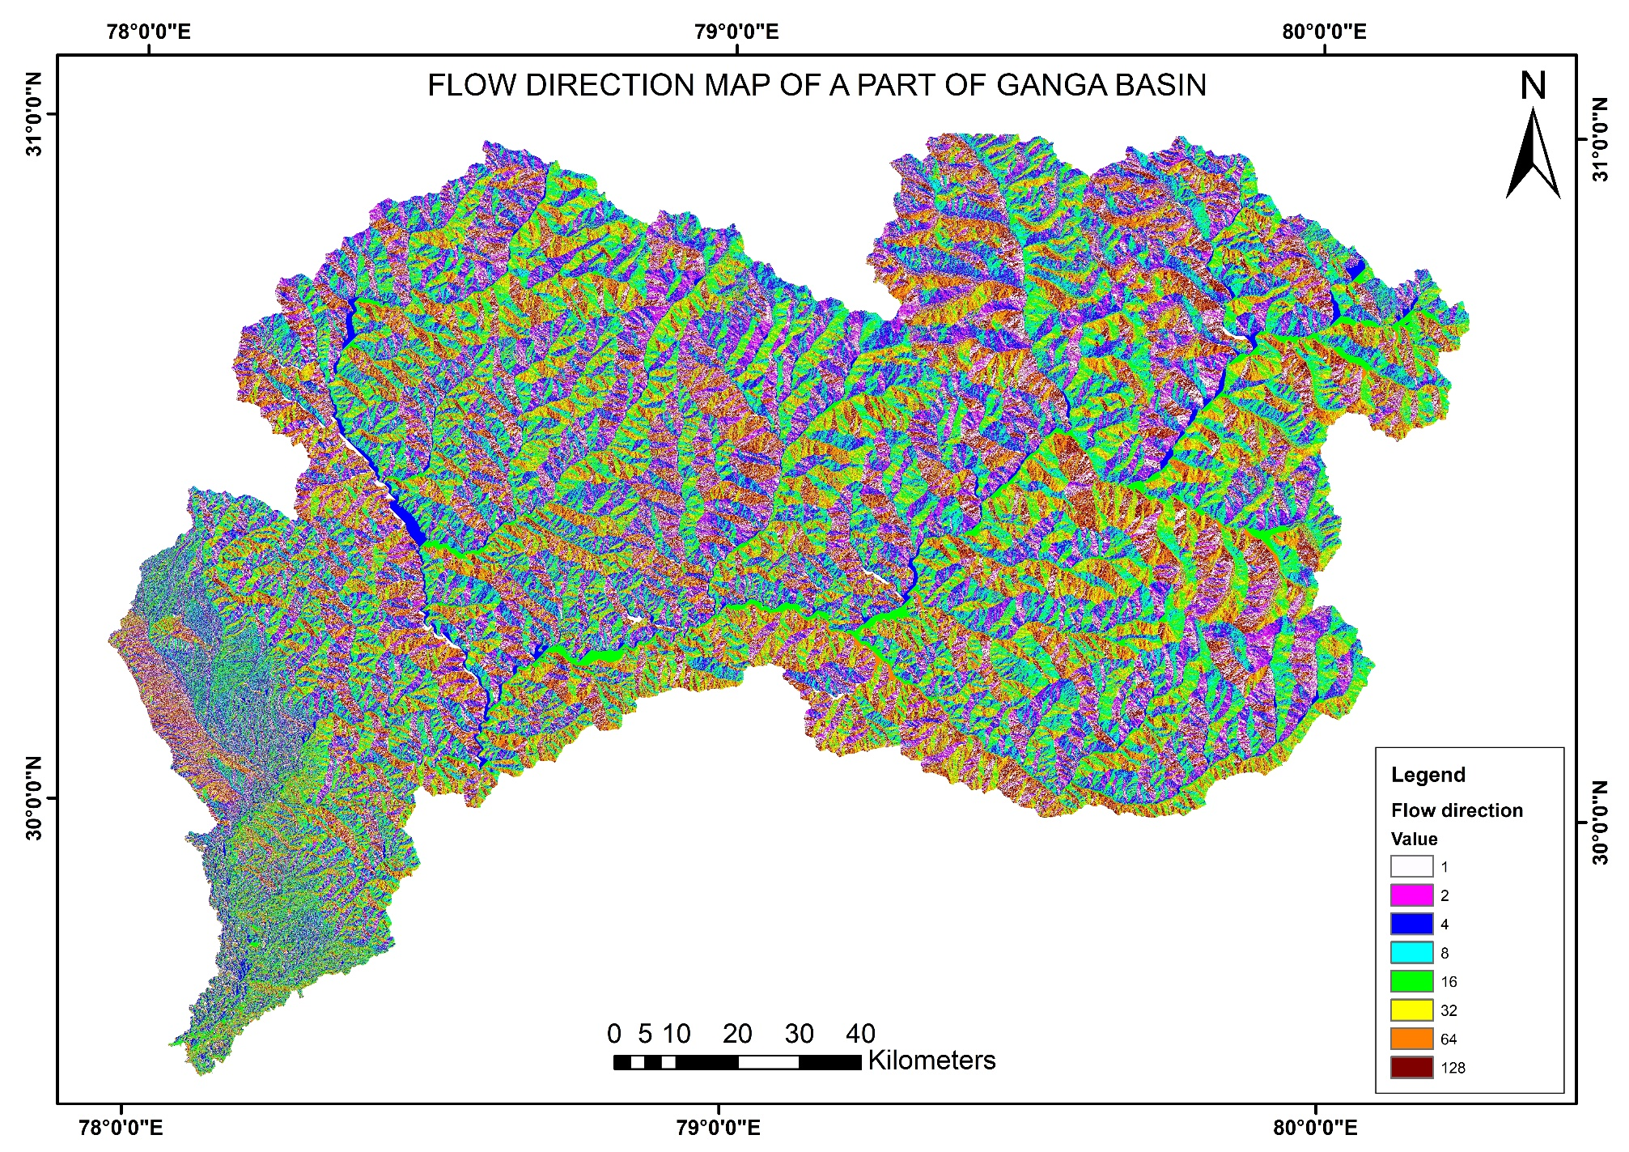

Slide 11
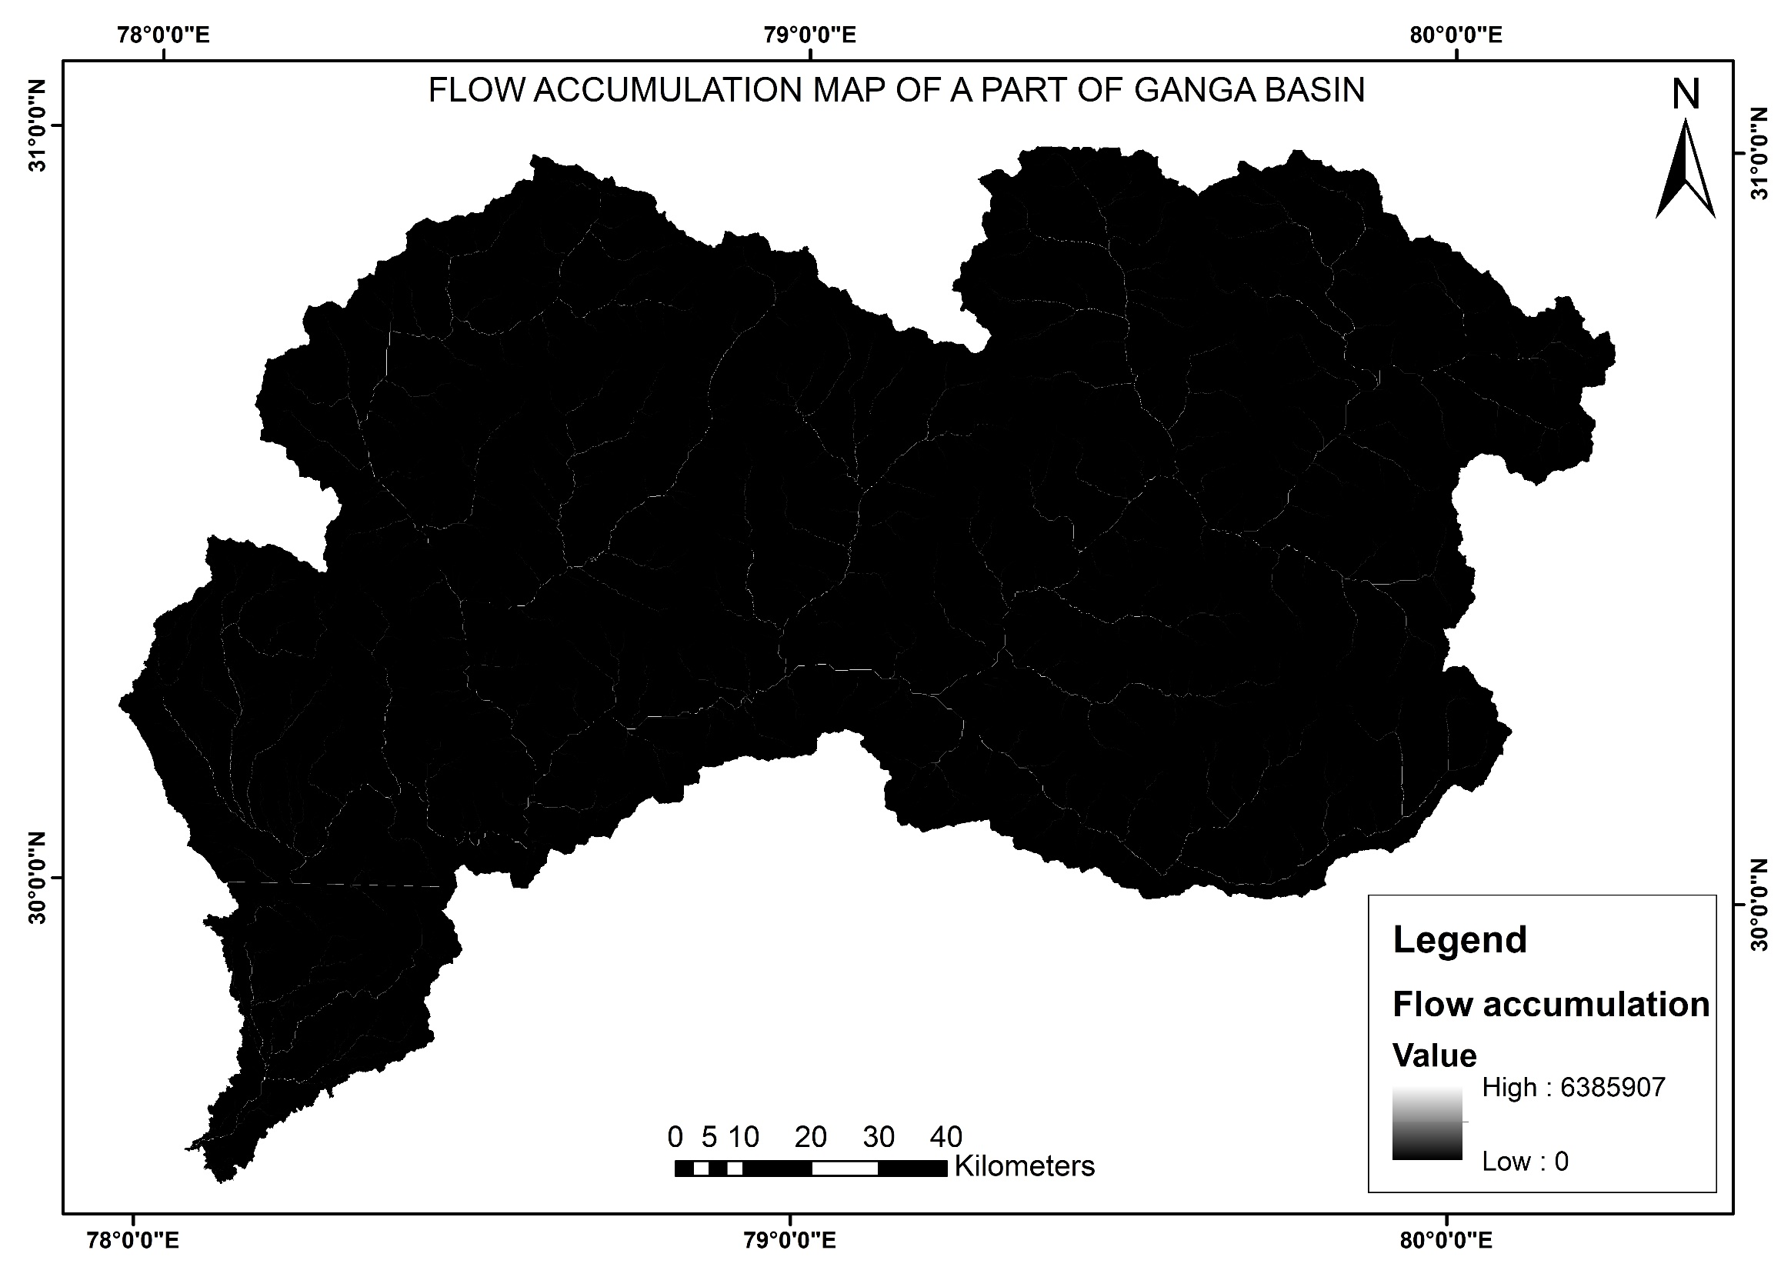

Slide 12
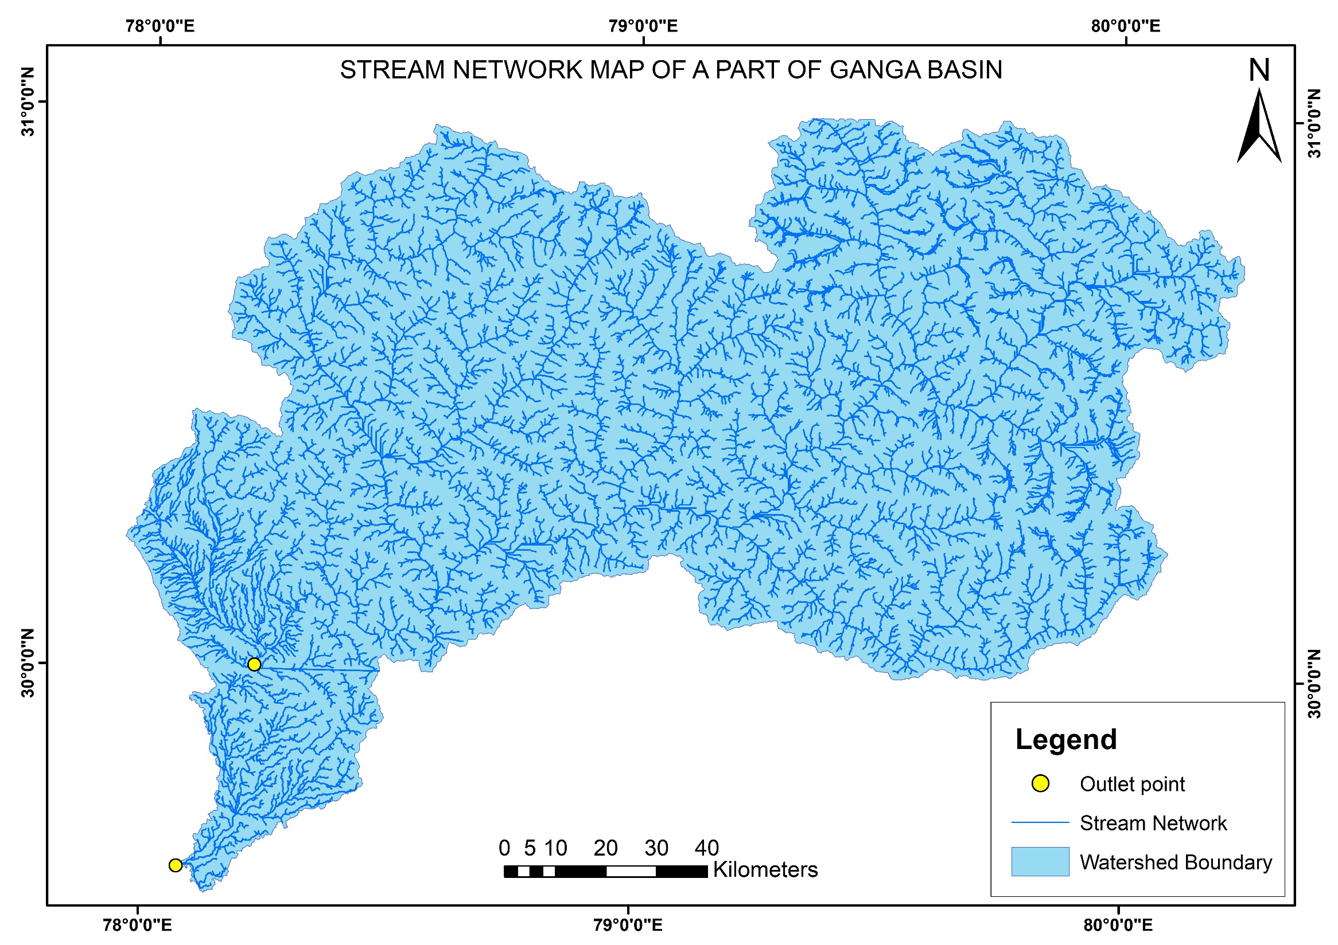
Flow accumulation threshold: 1000

Slide 13
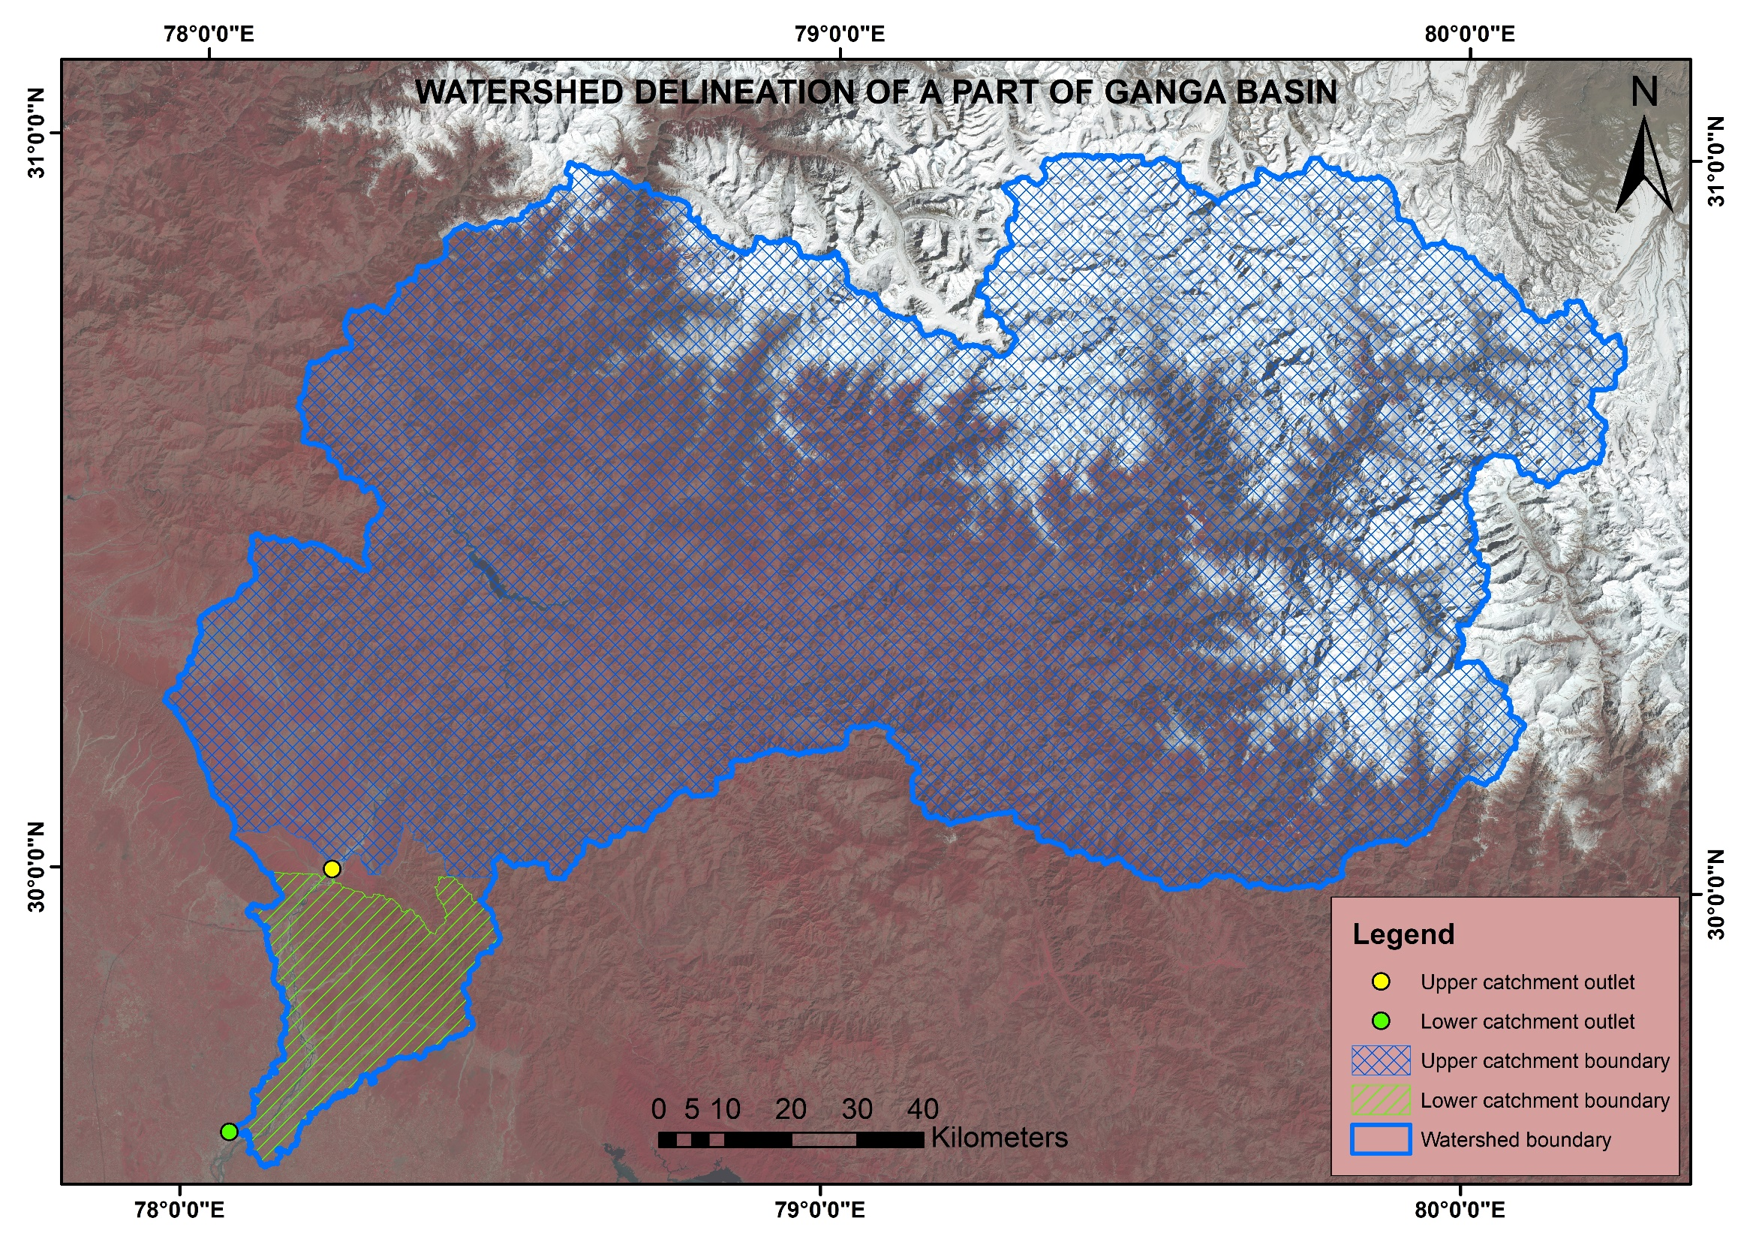

Slide 14
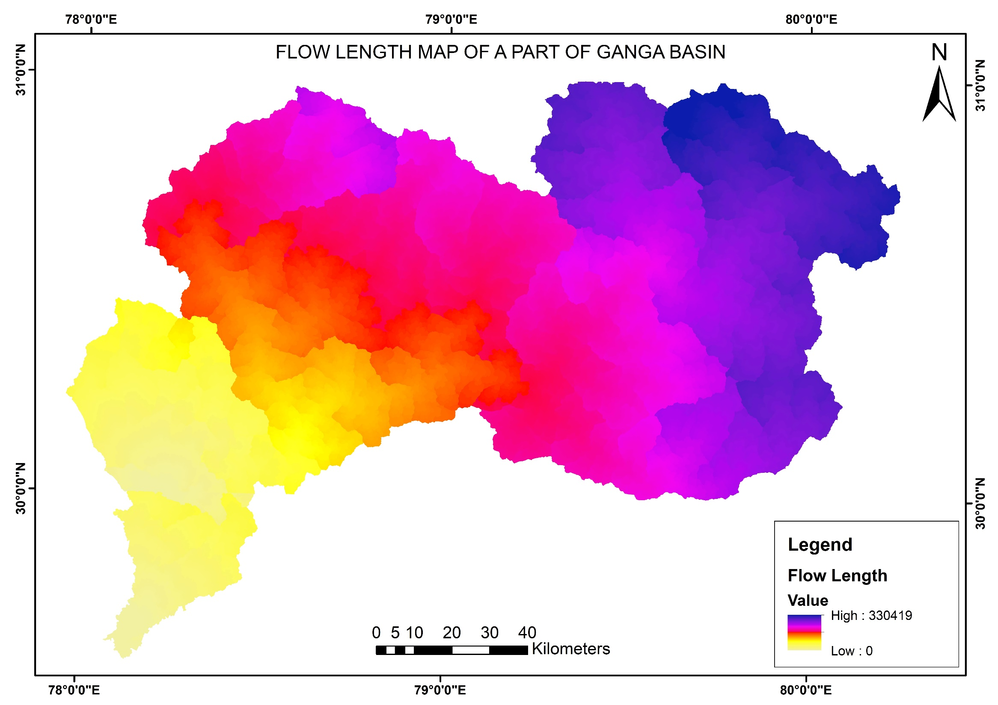

Slide 15
MORPHOMETRIC PARAMETER ANALYSIS

Slide 16

Basin Elongation Ratio
Predicts the tectonic activity of the basin
$Re=\frac{\left[\frac{(2×A)}{D}\right]}{L}$
A = Basin area=18360 sq km
D = Diameter of circle=152.93 km
L = Basin length=330.419 km
Re < 0.50, Tectonically active
Re = 0.50 – 0.75, Slightly active
Re > 0.75, Inactive

Slide 17
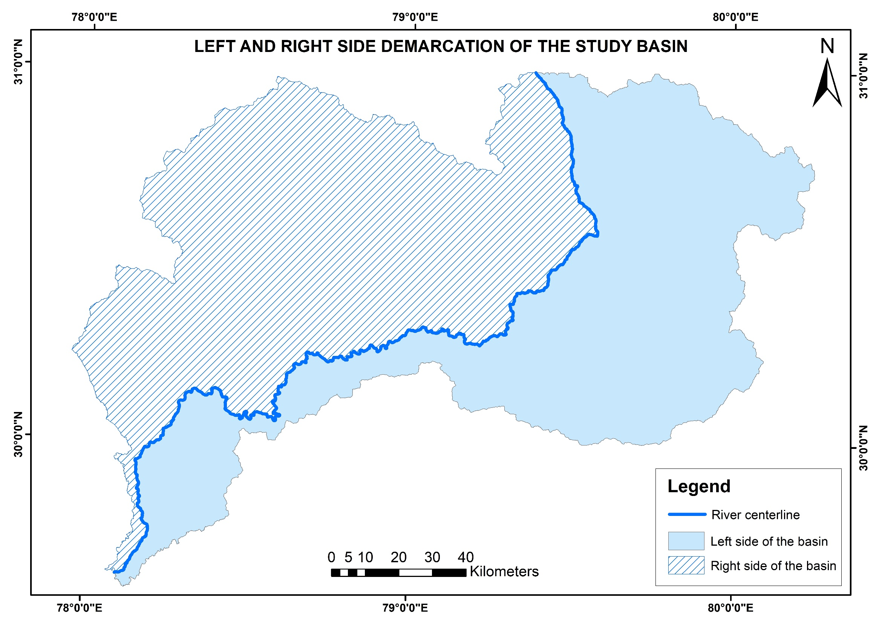

Slide 18

Asymmetric Factor
A qualitative index
Evaluates basin asymmetry
$AF= \left[\frac{Ar}{At}\right]×100$
Ar = Right hand side area of basin = 9834 sq. km
At = Total area of drainage basin = 18360 sq. km
AF = 50, Stable setting environment
AF $≠$ 50, Tilt

Slide 19
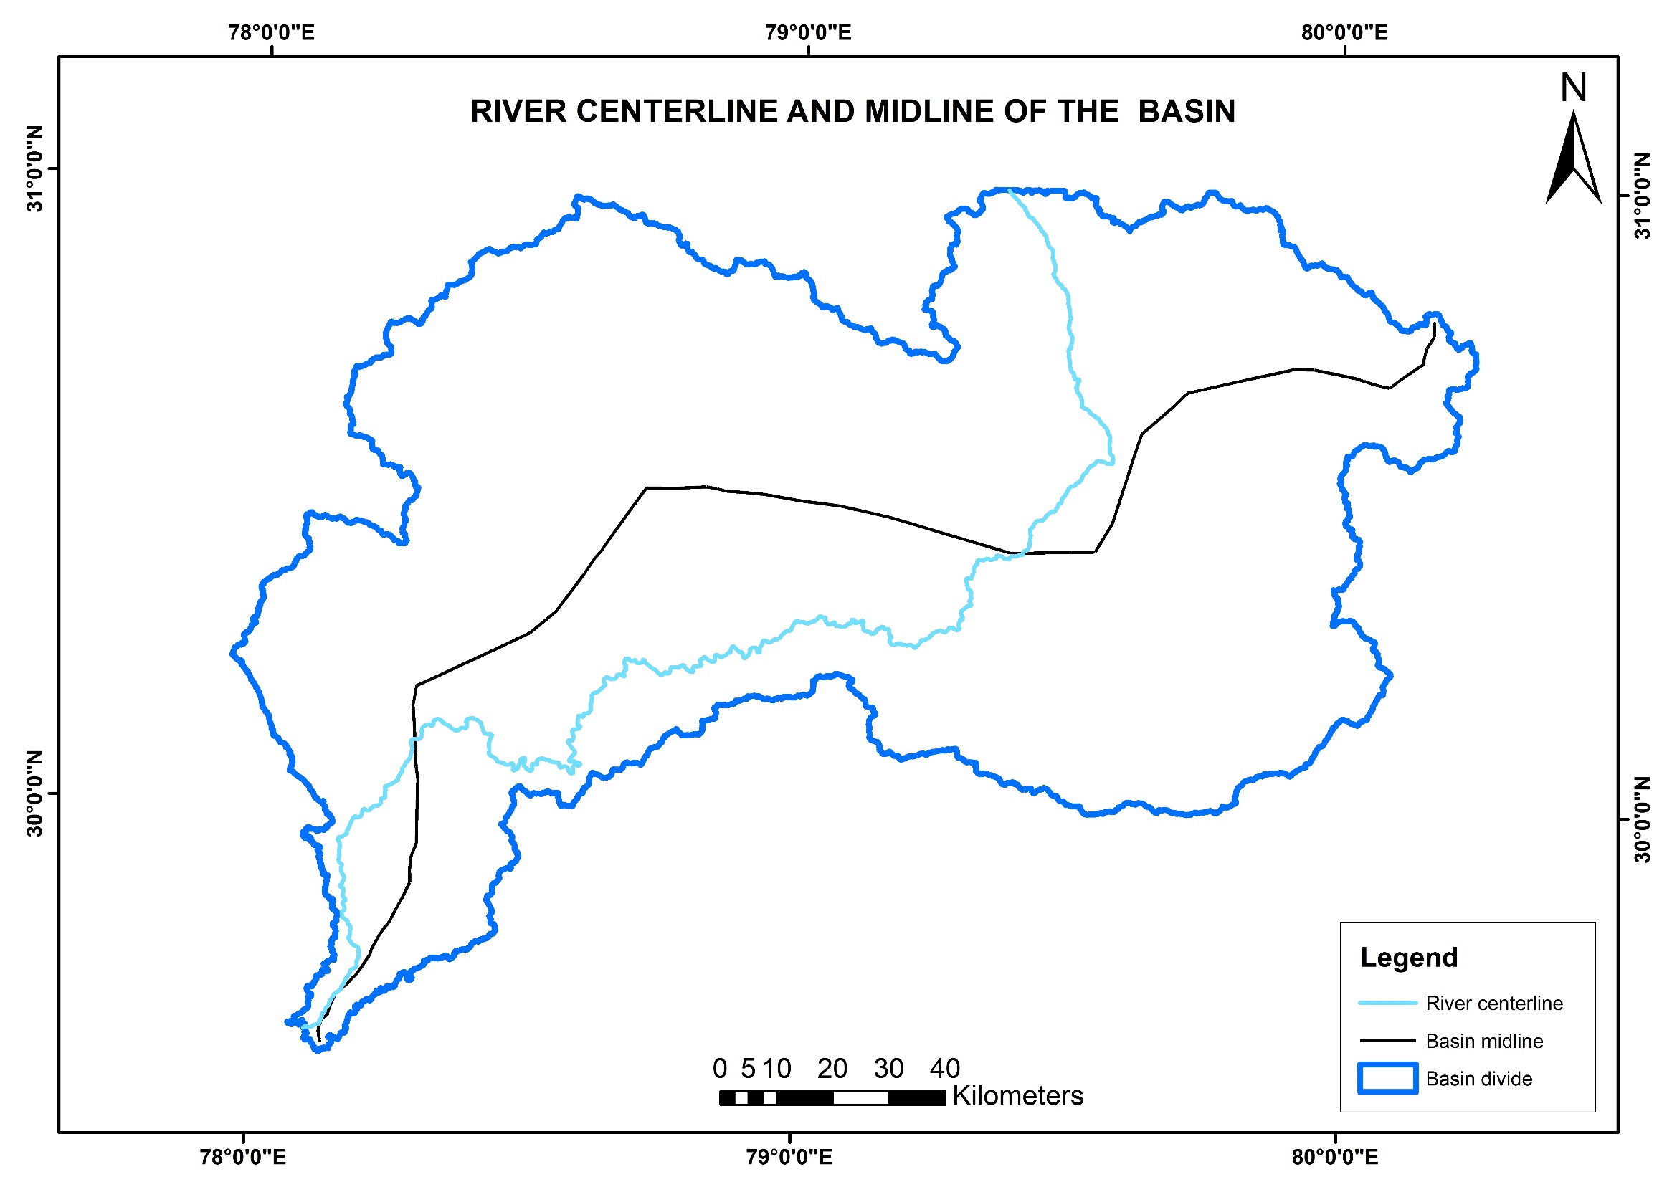

Slide 20
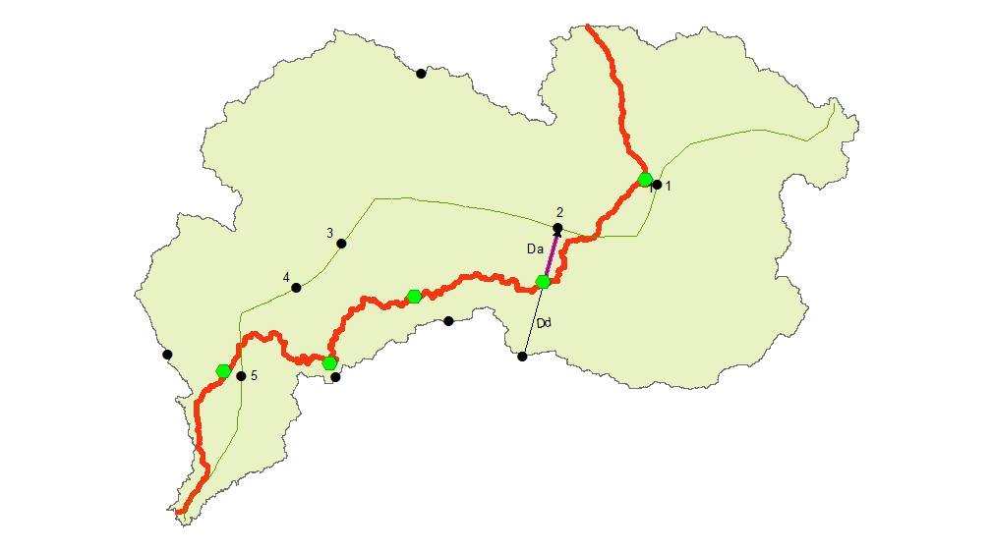

Slide 21

Transverse Topographic Symmetry
Shows lateral tilting which maybe related to active tectonics
$T= \frac{Da}{Dd}$
Da =Distance from midline of drainage basin to
Dd = Distance from basin midline to basin divide
Da | Dd | Symmetry Index
3836.186 | 79314.27 | 0.0483
17082.89 | 40674.53 | 0.4199
27433 | 40439.29 | 0.6783
25298.62 | 29745.53 | 0.8505
5239.98 | 23380.38 | 0.2241
T = 0, Symmetric Basin
T > 0, Asymmetric Basin

Slide 22
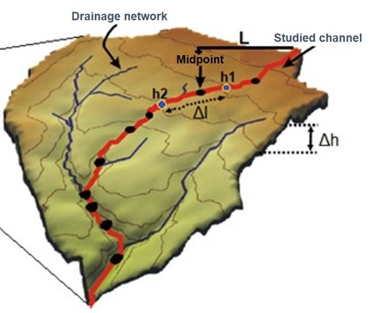

Stream Length Gradient Index
It is used to determine anomalies in the natural concavity at the longitudinal profile.
$SL= \left(\frac{∆H}{∆L}\right)×L$
$∆H$ = Change in elevation
$∆L$ = Length of the ridge
L = Total channel length from point of interest

Slide 23
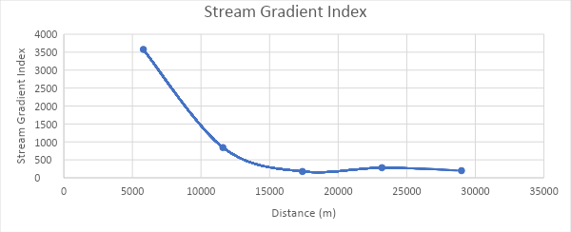

Slide 24
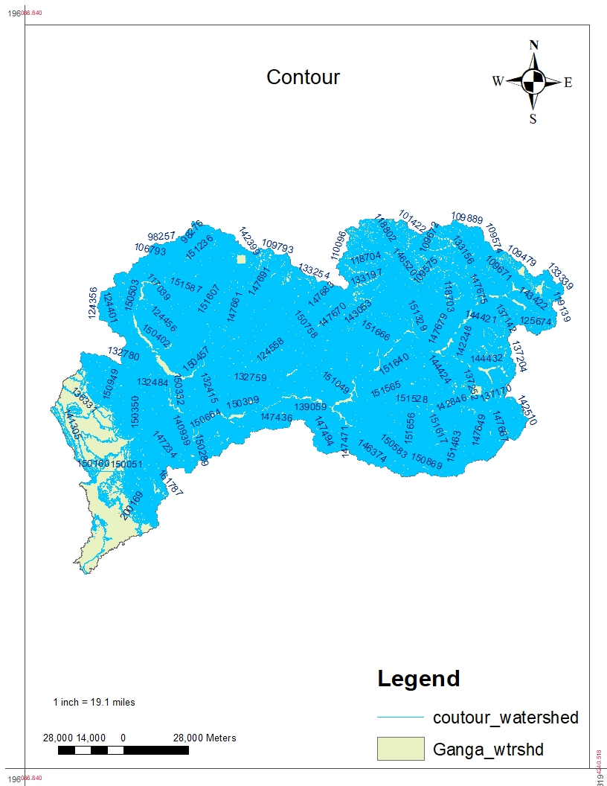

Valley Floor Width to Valley Height Ratio
Tells about mountain ranges front
Used to differentiate between valleys carved by glaciers or streams
We are using it to identify portions of a range front whether it is experiencing tectonic activity or not
$Vf= \frac{2×Vfw}{[\left(Eld−Esc\right)+\left(Erd−Esc\right)]}$

Slide 25
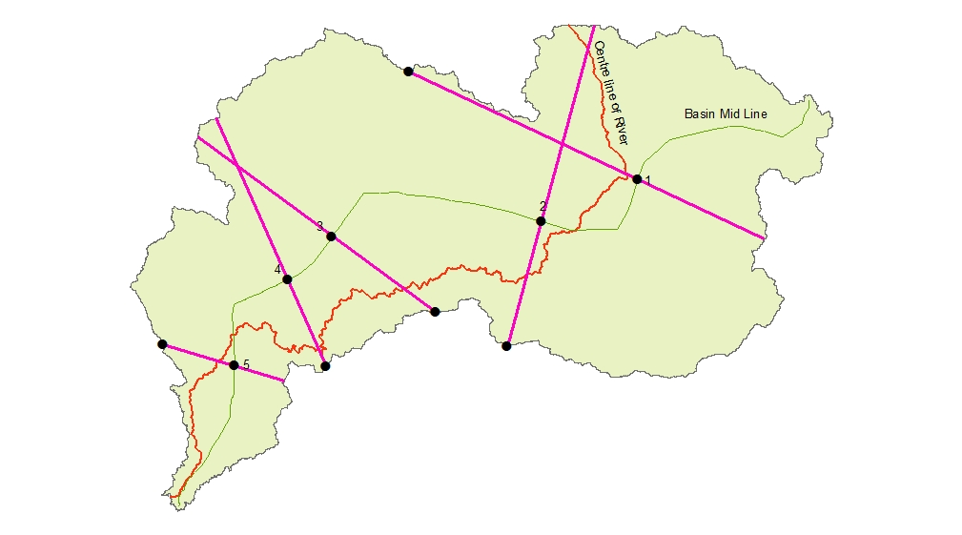

Slide 26
Right-side Elevation(m) | Left-side elevation(m) | Bottom-side elevation(m) | Width(m) | Valley Floor to Valley Width Ratio (Vf)
151686 | 151656 | 1438 | 20 | 0.000133
150664 | 151666 | 771 | 130 | 0.000864
151329 | 151148 | 595 | 190 | 0.00126
151148 | 146150 | 428 | 113.26 | 0.000764
150289 | 161787 | 313 | 1965.28 | 0.0126

Slide 27
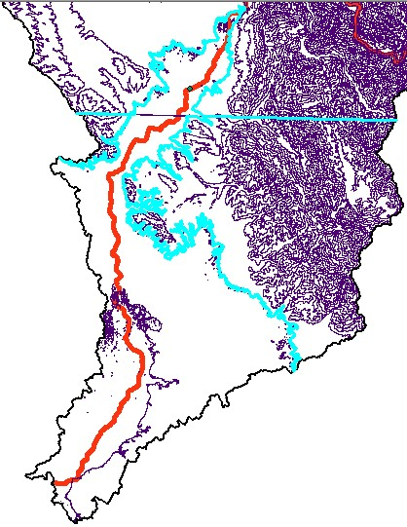

Mountain Front Sinuosity
Index that reflects the balance between erosional forces and tectonic forces
$Smf= \frac{Lmf}{Ls}$
Lmf = Length of the mountain front along the foot of the mountain= 361680 m
Ls = Straight-line length of the mountain front=139528.5 m
Smf < 1.4, Tectonically Active
Smf = 1.4-3, Slightly Active
Smf>3, Inactive Setting

Slide 28

Morphotectonic Analysis Results
Morphotectonic parameters | Formulae | References | Values, Inferences | Range of the present values
Basin elongation ratio (Re) | $$Re=\frac{\left[\frac{(2×A)}{D}\right]}{L}$$ | Bull and McFadden (1977) | Re < 0.50, Tectonically Active Re = 0.50 - 0.75, Slightly Active Re > 0.75, Inactive settings | 0.72 Slightly active
Asymmetry factor (AF) | $$AF= \left[\frac{Ar}{At}\right]×100$$ where Ar = Right hand side area of drainage looking downstream and At = Total area of drainage basin | Cox (1994) | AF = 50, Stable Setting environment AF <50, Suggest Tilt | 53.56 Slight tilt
Topographic symmetry factor (T) | $$T= \frac{Da}{Dd}$$ Where Da =Distance from midline of drainage basin to midline of active channel and Dd = Distance from basin midline to basin divide | Cox (1994) | T = 0, Symmetric Basin T > 0, Asymmetric Basin | 0.0483 - 0.8505 Asymmetric basin

Slide 29

Morphotectonic parameters | Formulae | References | Values, Inferences | Range of the present values
Stream length gradient index | $$SL= \left(\frac{∆H}{∆L}\right)×L$$ | Hack (1973) | - | 99.55 – 2383.77
Valley floor to valley width ratio (Vf) | $$Vf= \frac{2×Vfw}{[\left(Eld−Esc\right)+\left(Erd−Esc\right)]}$$ where Vfw = Width of valley floor, Eld&Erd = Elevation of the left and right valley divides respectively and Esc = Elevation of valley floor | Bull and McFadden (1977) | Low Values - Deep Valleys, Active Incision High Values - Broad Valleys | 0.000133 - 0.0126 Deep valley, Active incision
Mountain front sinuosity (Smf) | $$Smf= \frac{Lmf}{Ls}$$ where Lmf is the length of the mountain front along the foot of the mountain i.e mountain piedmont junction and Ls is the straight-line length of the mountain front | Bull and McFadden (1977) | Smf < 1.4, Tectonically Active Smf = 1.4-3, Slightly Active Smf>3, Inactive Setting | 2.5 Slightly Active

Slide 30
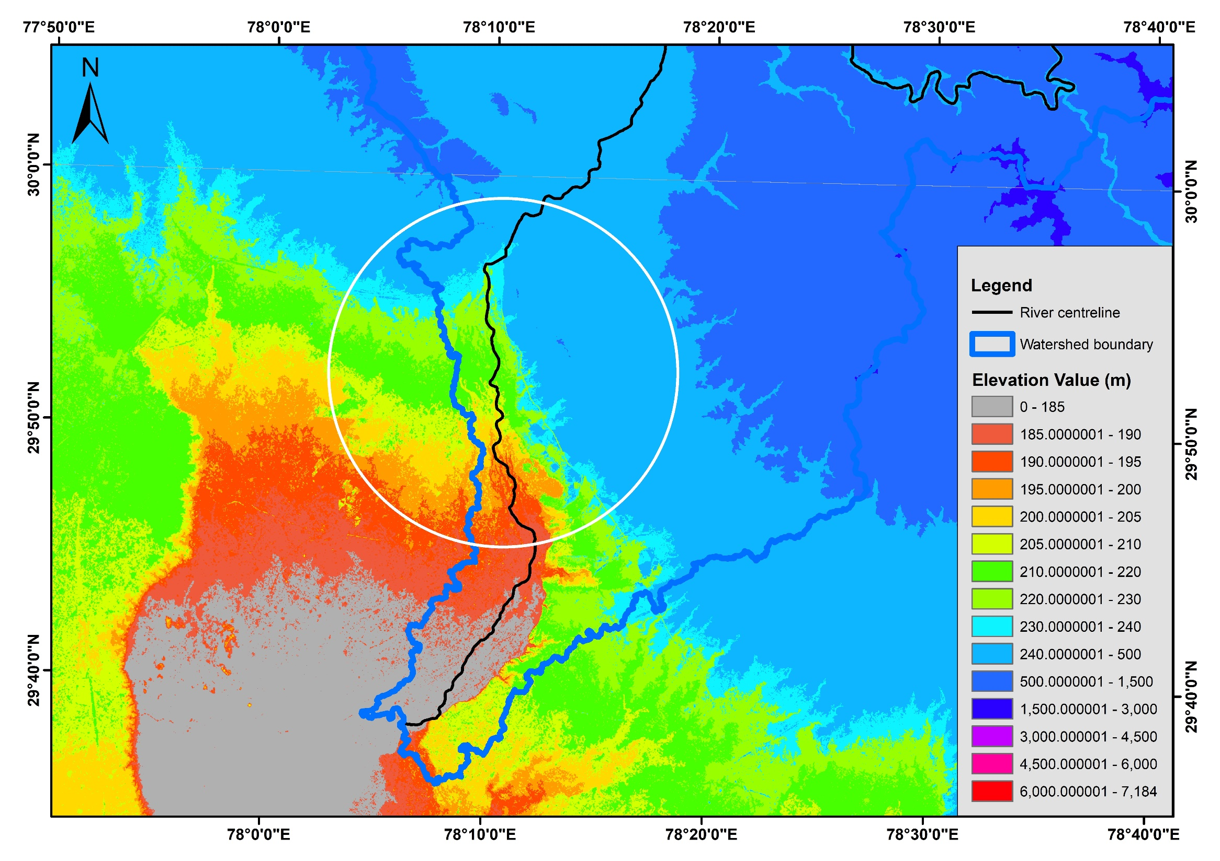
Sudden change in the river direction inferring tectonic influence

Slide 31
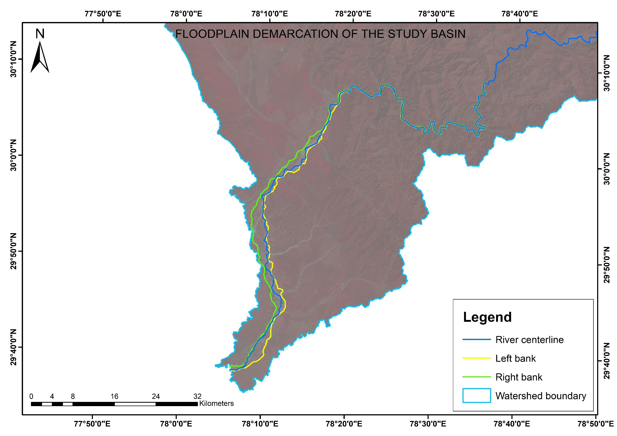

Slide 32
Inferences/Observations
The morphotectonic analysis of a part of the Ganga basin inferred the following:
the study basin is asymmetric in nature and slightly tilted
the study basin is tectonically slightly active
the study basin has deep valleys and active incision
Downstream of the Bhimgoda barrage, a sudden change in the river direction was observed which may be influenced by tectonic activities in that part
Again, the floodplain demarcation of the basin showed that in the downstream of the Bhimgoda barrage, the river centerline approached towards the left bank for a certain length and then again approached towards the right bank.

Slide 33
References
Anand, A.K., Pradhan, S.P. (2019) Assessment of active tectonics from geomorphic indices and morphometric parameters in part of Ganga basin. Journal of Mountain Science 16(8). https://doi.org/10.1007/s11629-018-5172-2
Bull WB, McFadden LD (1977) Tectonic geomorphology north and south of the Garlock Fault, California. Proceedings of the Eighth Annual Geomorphology Symposium, in: Geomorphology in Arid Regions, Doehring, D. O., (Ed), State University of New York, Binghamton 115-138.
Cox RT (1994) Analysis of drainage-basin symmetry as a rapid technique to identify areas of possible Quaternary tilt-block tectonics: an example from the Mississippi Embayment. Geological Society of America Bulletin 106(5): 571-581. https://doi.org/10.1130/00167606(1994)106<0571:AODBSA>2.3.CO;2
Dar, R.A., Romshoo, S.A., Chandra, R., & Ahmad, I. (2014) Tectono-geomorphic study of the Karewa Basin of Kashmir Valley. Journal of Asian Earth Sciences 92 (2014) pp.143–156. http://dx.doi.org/10.1016/j.jseaes.2014.06.018
Hack JT (1973) Stream-profile analysis and stream-gradient index. Journal of Research of the U.S. Geological Survey 1(4): 421-429. http://pubs.er.usgs.gov/publication/70161653
Keller, E. (1986) Investigation of active tectonics: use of surficial earth processes. In: Wallace Re (Eds.). Active tectonics studies in Geophysics. National Academy Press, Washington, D.C., pp.136-147
Thomas, J., Joseph, S., & Thrivikramaji, K. P. (2010) Morphometric aspects of a small tropical mountain river system, the southern Western Ghats, India. International Journal of Digital Earth, 3(2), 135–156. https://doi.org/10. 1080/17538940903464370

Slide 34
Contribution of the group members in the study
Aditya Kale (224104005): Manual demarcation of Floodplain, Literature Survey, Inferences/Observations
Ankit Chandelia (224357002): MSS data download & processing, manual digitization of River Centerline and River Network, Basin Elongation Ratio, Asymmetric Factor, Mountain Front Sinuosity Calculations, Inferences/Observations, Work compilation in .ppt format
Anmol Mohak (224357003): DEM data download & processing (SRTM DEM), Contour line generation, Basin midline demarcation, Literature Survey, Topographic Symmetry Factor, Stream Length Gradient Index, Valley Floor to Valley Width Ratio, Mountain Front Sinuosity Calculations, Inferences/Observations
Dipima Sarma (226157001): DEM data download & processing (CartoDEM), Flow Direction, Flow Accumulation, Flow Length Calculation, Stream Network Delineation, Watershed Delineation based on outlet selection, Watershed Area Calculation, Mapping of Important Locations, Attribute Data addition, Base Map preparation, Map Composition, Inferences/Observations, Work compilation in .ppt format

Slide 35
THANK YOU!

